Slide 1

Employment Management System
Presented By:
M.sai sharmista

Slide 2
Introduction:
The Employment Management domain requires efficient handling of employee records, departments, job roles, attendance, payroll, and performance evaluations.
Proper data management helps organizations streamline HR operations, ensure compliance, reduce manual errors, and improve workforce productivity.
This project simulates a complete Employment Management System with interconnected entities such as employees, departments, salaries, job positions, and attendance logs.
It offers hands-on experience in understanding organizational workflows and employee lifecycle data.
Students will use SQL to store, manage, and analyze employee-related information, enabling valuable administrative and managerial insights.
The goal is to enhance decision-making, automate HR processes, and improve organizational efficiency through structured data analysis.

Slide 3
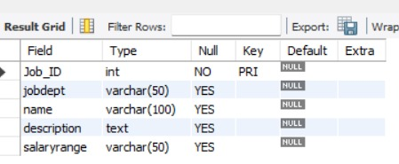
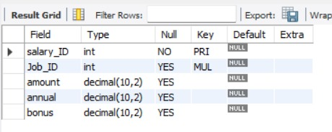
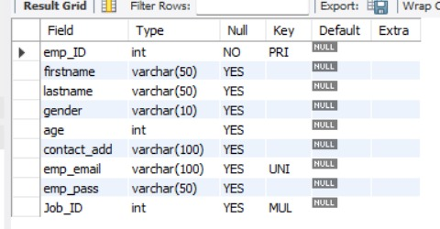
Tables
Job Department
Salary
Employee

Slide 4
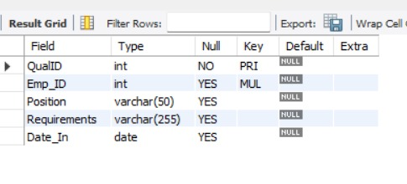
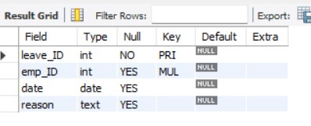
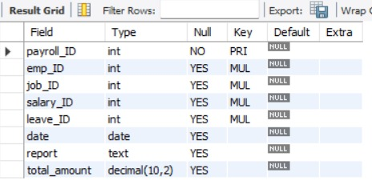
Tables
Qualification
Leaves
Payroll

Slide 5
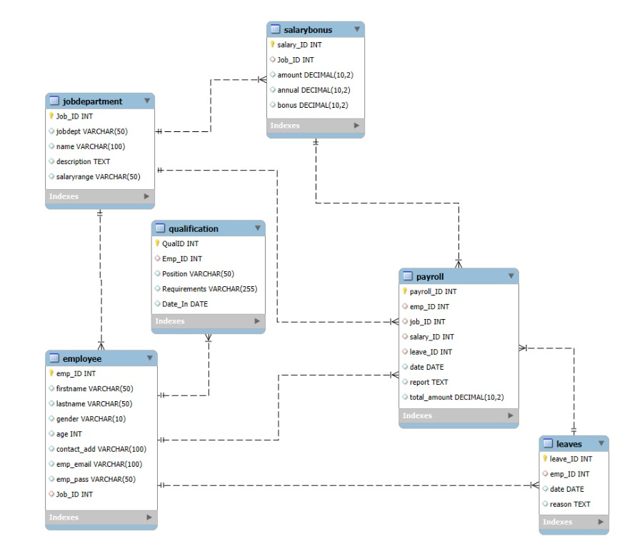
ER Diagram

Slide 6
Problem Statement
The objective of this project is to design and implement an Employee Management System that efficiently stores and manages employee-related data within an organization. The system needs to track various aspects of employee information, including personal details, job roles, salary structures, qualifications, leave records, and payroll data. The system should ensure the integrity and consistency of data by using relational tables with appropriate foreign keys and cascading actions.
The system should allow for easy management and querying of employee data, providing insights such as payroll calculation, leave tracking, and department-specific job roles. The goal is to streamline HR operations, ensuring that all relevant employee data is accessible and accurately updated across different modules.

Slide 7


EMPLOYEE INSIGHTS
1. How many unique employees are currently in the system?

Slide 8
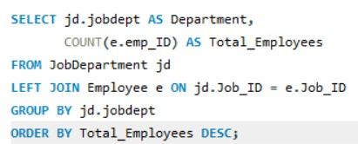
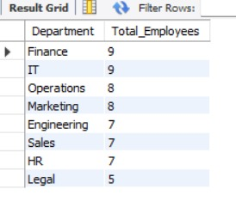
2. Which departments have the highest number of employees?

Slide 9
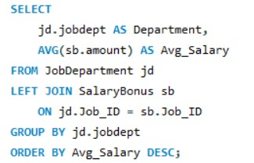
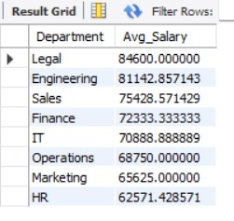
3.What is the average salary per department?

Slide 10
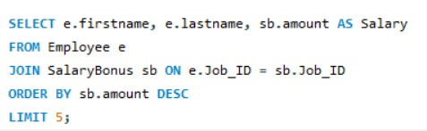
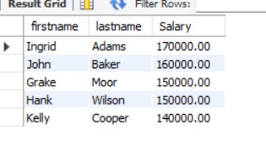
4. Who are the top 5 highest-paid employees?

Slide 11


5.What is the total salary expenditure across the company?

Slide 12
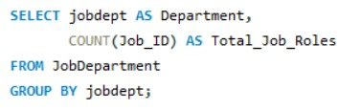
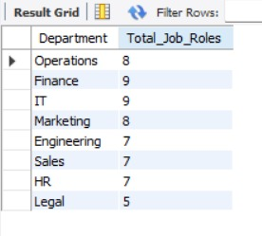
JOB ROLE AND DEPARTMENT ANALYSIS
6. How many different job roles exist in each department?

Slide 13
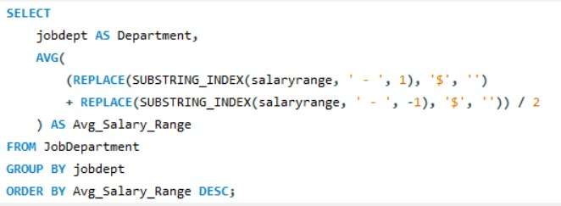
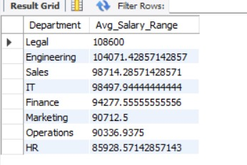
7. What is the average salary range per department?

Slide 14
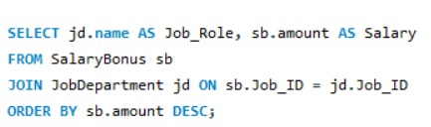
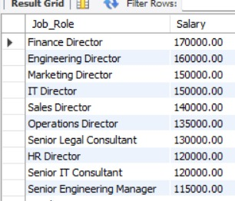
8. Which job roles offer the highest salary?

Slide 15
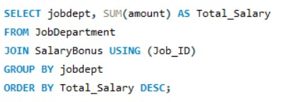
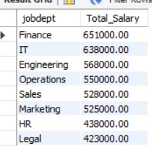
9. Which departments have the highest total salary allocation?

Slide 16

QUALIFICATION AND SKILLS ANALYSIS
10.How many employees have at least one qualification listed?

Slide 17
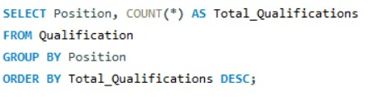
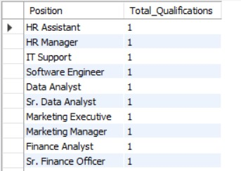
11. Which positions require the most qualifications?

Slide 18
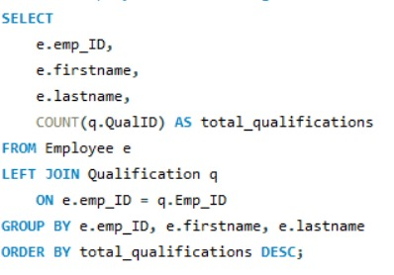
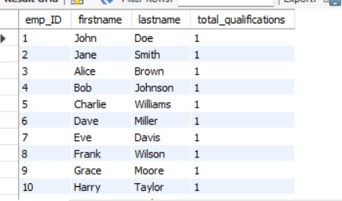
12. Which employees have the highest number of qualifications?

Slide 19
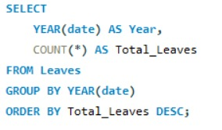

LEAVE AND ABSENCE PATTERNS
13. Which year had the most employees taking leaves?

Slide 20
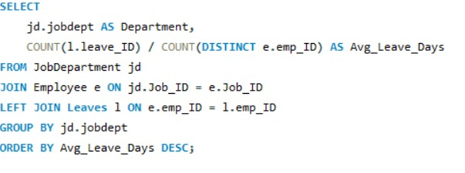
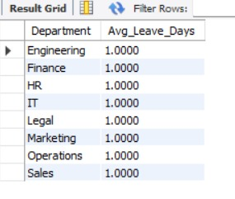
14. What is the average number of leave days taken by its employees per department?

Slide 21
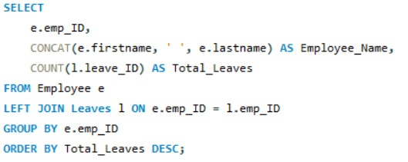
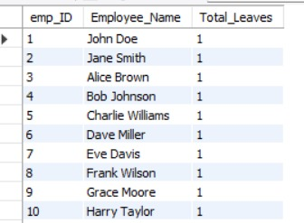
15. Which employees have taken the most leaves?

Slide 22

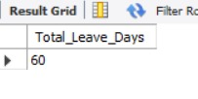
16. What is the total number of leave days taken company-wide?

Slide 23
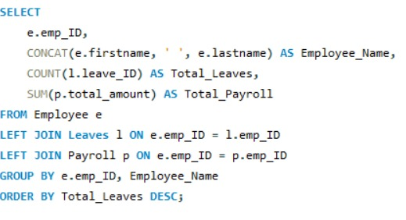
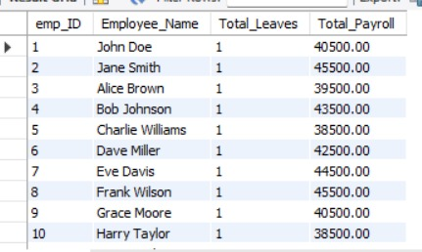
17. How do leave days correlate with payroll amounts?

Slide 24


PAYROLL AND COMPENSATION ANALYSIS
18. What is the total monthly payroll processed?

Slide 25
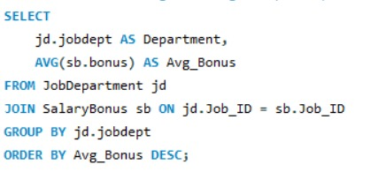
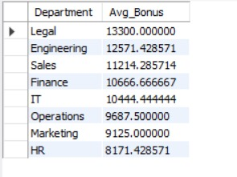
19. What is the average bonus given per department?

Slide 26
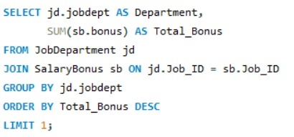

20. Which department receives the highest total bonuses?

Slide 27


21. What is the average value of total_amount after considering leave deductions?

Slide 28
Challenges faced
Designing correct table relationships and ER diagram with proper keys.
Writing complex SQL queries involving multiple joins and aggregations.
Handling null values, data consistency, and payroll calculations with leave deductions.
Debugging SQL errors and aligning query outputs with business requirements.

Slide 29
conclusion
Successfully designed and implemented an Employee Management System using relational tables.
Ensured data integrity and reduced redundancy using primary and foreign keys.
Generated meaningful HR insights using SQL joins, aggregate functions, and queries.
Improved understanding of real-world HR data management and analysis.

Slide 30
Thank You

